Slide 1
Software Design for Data Science
Project Proposals
DATA 515 Students
University of Washington
February 7, 2023

Slide 2
Proposals & Team Formation
During project proposals:
Volunteer to present!
Take notes on what projects sound interesting to you
After project proposals:
You’ll have time in class to talk to each other and form teams around a project proposal
3-4 people per team (4 is optimal)
If a team has 1-2 people and can’t find more people or a project, I will help coordinate

Slide 3
Projects
Airbnb Recommender – Top 5 Airbnbs in your Desired City in the US
Airline Crew Pairing/Scheduling
Airline Delay Prediction
Analyzing Academic Sexual Misconduct
Analyzing the Wisconsin Wolf Population
Anomaly Detection in Financial Transactions
BEAT THE CROWD! *
Beers, Breweries, and Better Choices
Car Decision Making Interactive Helper
Charge Me Up!
Climate Change and Wildfire in the US

Slide 4
Projects, Part 2
COVID19: Patient impact and State policy
Create an API Overlay for Smogon.com
Crime Analysis *
Crime under the Weather
Customer Personality Analysis
Data Analysis: Rotten Tomatoes and the Oscars
Electric Vehicle Charging Heat Map
Exploring Weather Trends
Face Extractor Tool
Food Deal-ivery *
FRAME - Food Recommendations For All Methodical Eaters
Global Power Plants and Energy Consumption Analysis

Slide 5
Projects, Part 3
Impact of Sci-Fi among Fictions over the Years
Kaggle Genie
Monte Carlo LVII
Multilingual OCR for Indic Scripts
Orphaned Well Mapping Tool
Parking Spot Finder *
Pet Palette: Your Guide to Adoptable Paws Heat Map & Breed Comparison
Popular Video Games
Recipe Generator
Relation between crime rates and housing prices in Seattle
Seattle Weather Prediction
Sleep Research

Slide 6
Projects, Part 4
Speech To Text Engine
STUDY OF GLOBAL PROGRESS TOWARDS SUSTAINABLE DEVELOPMENT GOALS
Term Rate Conversion for Banks
Tourist Places Recommendation System
Twitter Interactions – a guide to bots, shills and echo chambers
Unsupervised image clustering
UW Alerts Application
VACATION FINDER
VIDEO GAME ANALYSIS
WA State Public School Visualization
Where to Park?
Why is Kramer the best character?

Slide 7
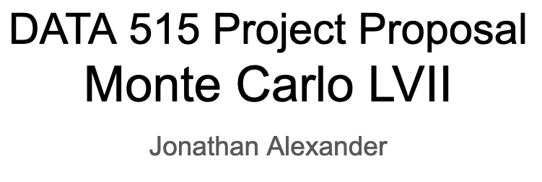
Description
Type: Tool
The tool will allow users to run monte carlo simulations for various NFL matchups based on player data and past team performance. With the super bowl coming up it will be interesting to see how if we are able to see how accurately we are able to simulate general match-ups and the upcoming super bowl game in particular.
Data Sources (tentative):
Per player stats: https://www.kaggle.com/datasets/zynicide/nfl-football-player-stats
Past Super Bowl Matchups: https://www.kaggle.com/datasets/timoboz/superbowl-history-1967-2020
Player Participation Data: https://www.kaggle.com/datasets/toddsteussie/nfl-play-statistics-dataset-2004-to-present
Team Stats and Outcomes: https://www.kaggle.com/datasets/thedevastator/nfl-team-stats-and-outcomes

Slide 8
Beers, Breweries, and Better Choices (Tool)
Chandler Ault
Pitch:
Have you ever been at the grocery store or brewery and been paralyzed by the number of different beers to choose from? Be paralyzed no longer. My pitch is to combine beer and brewery datasets to create a tool for finding beers and breweries that best match the user’s preferences. We can match the beers based on metrics like IBU, astringency, and more! Another feature we could add is a user could input multiple beers they are trying to choose from and our tool would output their best match.
Data Sources:
https://www.openbrewerydb.org/documentation
https://www.kaggle.com/datasets/ruthgn/beer-profile-and-ratings-data-set?select=beer_profile_and_ratings.csv

Slide 9
Customer Personality Analysis – Research
Ameya Bhamare
Summary
Customer Personality Analysis is a detailed analysis of a company’s ideal customers. It helps a business to better understand its customers and makes it easier for them to modify products according to the specific needs, behaviors and concerns of different types of customers.
For example, instead of spending money to market a new product to every customer in the company’s database, a company can analyze which customer segment is most likely to buy the product and then market the product only on that segment.
Why do I want to work on this?
Honestly, I have an ulterior motive. With petabytes of data being generated by most companies, this project would look good on data science resume
Secondly, there’s a plethora of data out there with no bounds on how it can be juiced
Thirdly, I enjoy understanding how people interact with brands
Data sources
Customer Analysis
Starbucks Customer Data

Slide 10
DATA515 Project: WA State Public School Visualization By Matthew Blake
goal: to create a visualization that captures the academic quality/performance of each school district in wa state. this visualization in factor in metrics such as student growth, student performance, classroom teachers and class size etc.
project type: visualization tool
data sources (tentative):
Washington Office of Superintendent of Public Instruction (https://washingtonstatereportcard.ospi.k12.wa.us/)
Washington Geospatial Open Data Portal (https://geo.wa.gov/datasets/23bbd746f9924c149681815cfd2a6300_0/explore?location=47.272273%2C-120.802250%2C7.47)

Slide 11
Multilingual OCR for Indic Scripts
~ Soham Butala
Project Type : Research / Tool
A document analysis system in India must support multiple languages at the same time. With emerging multilingualism in urban India, it is often necessary to support bilingual, trilingual, or even more languages. This demands development of a multilingual OCR system which can work seamlessly across Indic scripts.
Dataset :
https://github.com/ssun32/CLIRMatrix
https://github.com/project-anuvaad/anuvaad-parallel-corpus

Slide 12

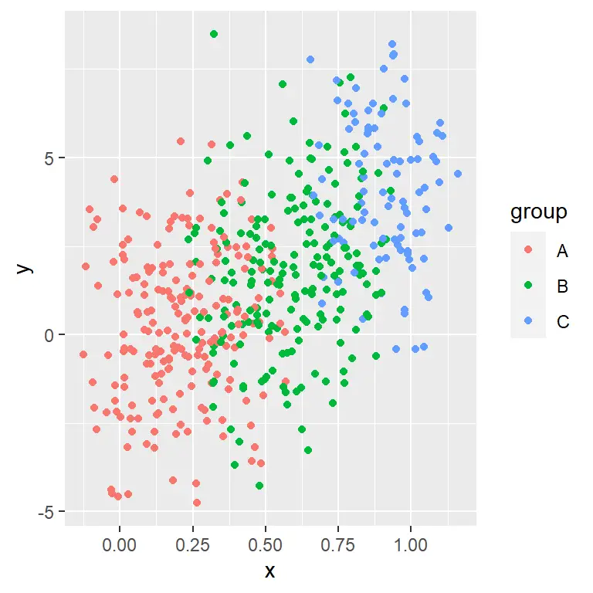
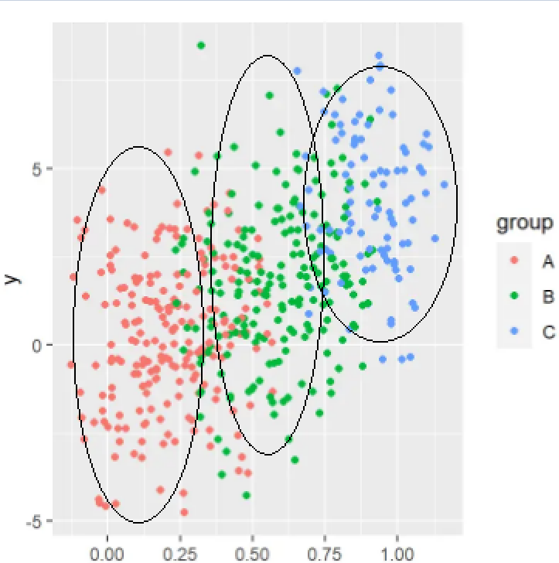

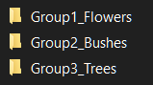

Unsupervised image clustering
Zachary Bowyer
Image clustering can be useful for various detection tasks. For this project, we will be combining the power of unsupervised clustering algorithms, principal component analysis, and an interactive visualization to allow users to specify image clustering rules for future grouping (Tool).
Step 1: Get image batches
Step 2: Run K-means/DBSCAN to get cluster recommendations
Step 3: Plot all images on a 2D plot using PCA, color code based on recommendations
Step 4: Give user ability to select areas of the plot to classify as an image type/group
Step 5: Run new images through user selected groups and output to folders.
Data source 1: https://www.kaggle.com/datasets/pavansanagapati/images-dataset
Data source 2:
https://cocodataset.org/#home

Slide 13

Popular Video Games
Marques Chacon
Project Output: Reusable Data and Tool
Creating a bar graph distribution with a time slider to show changes in most common video game genres
Building an interactive dashboard that highlights sales, target demographics, and playing time for different games, with dropdown filters for a specific gaming platform
Use a machine learning model to predict sales for a particular game, which could be useful for game developers
Data
Two datasets from Kaggle:
Data scraped from RAWG (video game database)
Video game sales data and critic review scores

Slide 14
*
CRIME ANALYSIS
Prerit Chaudhary
Project Type : Research
Objective
By examining the data, it's evident that the crime rate has reduced over the last few years. To better understand the cause of this change, I plan to drill down on the underlying factors such as socio-economics and demographics using time-series, spatial, and statistical analysis. Some of the points I would like to explore are:
What has been the % change in different types of crime?
What are the specific age groups for victims and suspects?
Evaluate if there is correlation between economic conditions, such as poverty and unemployment and crime rates.
Is there any pattern between type of crime and time of the day when it is happening.
Geospatial or Geographic analysis for each crime and deep dive using Demographic data.
Data Source
Data.gov
United States Department of Labor
Kaggle

Slide 15

Pet Palette Your Guide to Adoptable Paws Heat Map & Breed Comparison
Business (or personal) questions of interest:
Where can I adopt a dog or cat of a specific breed?
What specific breed of dog or cat would be a good fit for my household?
Project Output: a tool (simple web app)
User Selects
Animal type
Up to 3 (maybe 5?) breeds
Location (state dropdown)
Visualizations on screen would filter based on the selections
Heat map displaying concentrations of adoptable pets of selected breed(s)
Comparisons of: Life expectancy, friendliness, shedding, etc
Data
PetFinder API (heat map)
Dog Traits: https://tmfilho.github.io/akcdata/
Cat traits: https://altef.github.io/logipar/

Slide 16
STUDY OF GLOBAL PROGRESS TOWARDS
SUSTAINABLE DEVELOPMENT GOALS
Name: Anish Dixit
Project Type: Research / Analysis
Project Details:
In 2015, the UN has defined 13 Sustainable Development Goals targeting different aspects of preservation of life on Earth to be attained by 2030.
It is important to gauge empirically how each country is working towards attaining the goals.
Did the Covid 19 pandemic have an effect on countries’ attainment of the SDGs?
Are there geographic/socio-economic factors determining how well a country/region fares in attaining SDGs?
Is any particular SDG easier to attain than others?
Data Sources: There is a lot of official data available on the UN website which can be used for analysing a variety of aspects, countrywise, goalwise, yearwise, and so much more.
https://unstats.un.org/sdgs/dataportal
https://unstats-undesa.opendata.arcgis.com/

Slide 17
Parking Spot Finder –April Gao
*
Project Type: Tool
Summary: The objective of this tool is to help user to increase their luck on finding street parking. After use input the destination address and arrival time, this tool will use historical paid parking occupancy to find parking spaces that are less likely to be occupied. This tool will also take public event and sport event into account when finding spots.
Datasets:
Seattle event calendar: https://www.seattle.gov/event-calendar
Paid Parking Occupancy: https://data.seattle.gov/Transportation/Paid-Parking-Last-48-Hours-/hiyf-7edq

Slide 18
Anomaly Detection in Financial Transactions
Project Output:
Tool (A simple web application)
Project Goals:
Develop a model (unsupervised or a semi-supervised) that can:
Detect fraudulent credit card transactions, insurance claims, mobile payments or E-commerce
Identify specific patterns or behaviors to find those fraudulent transactions
Perform the detection in real-time rather than offline
Perform detection with good accuracy:
Using an ensemble of ML algorithms
Balance the trade-off between false positives and false negatives
Alert relevant stakeholders when a potentially fraudulent transaction is detected.
Data Sources:
Credit Card Transactions Dataset (https://www.kaggle.com/mlg-ulb/creditcardfraud)
Car Insurance Dataset (https://www.kaggle.com/datasets/incarnyx/car-insurance-fraud)
Ecommerce Fraud Detection Data (https://www.kaggle.com/datasets/aryanrastogi7767/ecommerce-fraud-data)
Mobile Transactions (https://www.kaggle.com/datasets/ealaxi/paysim1)
Name:
Sagnik Ghosal

Slide 19
COVID19: Patient impact and State policy
By Nizan Howard
Type: Tool Project
Objective: To build a tool that can help provide data mining and a visual to help with analysis between the two data sets.
Allows comparative visualization between patient and hospital capacity on the state level.
Preprocess contextual data
Organizes and scales numeric data
Provides a visual representation of the preprocess completion
Tentative data sets:
Data set 1: https://healthdata.gov/dataset/COVID-19-Reported-Patient-Impact-and-Hospital-Capa/6xf2-c3ie
Data set 2 : https://healthdata.gov/dataset/COVID-19-State-and-County-Policy-Orders/gyqz-9u7n

Slide 20
Impact of Sci-Fi among Fictions over the Years
Research / Wanwei Huang
Goals:
Join the two datasets to see if Sci-Fis that are generally popular among fictions are popular among Sci-Fis.
To see how Sci-Fi evolves over time, what elements are becoming more popular among readers and what are they losing interest in. Could the shift be due to the development of technologies in our time?
Datasets:
https://www.kaggle.com/datasets/cmenca/new-york-times-hardcover-fiction-best-sellers
https://www.kaggle.com/datasets/tanguypledel/science-fiction-books-subgenres?select=sf_time_travel.csv

Slide 21
James Joko
Project Type: Research
I would like to research the effect of different life habits on the quality and efficiency of sleep and sleep patterns (REM, Deep, Awakenings). Different habits I would look into include smoking, alcohol consumption, and exercise frequency/duration.
Data Sources:
Sleep Study Dataset
FitBit Fitness Tracker Dataset

Slide 22
VIDEO GAME ANALYSIS
Project Type: Reusable Data
Questions:
What are the most popular video game genres?
Do video games with higher ratings correlate with higher sales?
Are games that can be beaten more easily rated higher?
Does playtime affect sales?
Data Sources:
RAWG Dataset: Contains 474417 videogames, scrapped using RAWG API.
Video Game Sales: Includes games with sales over 100,000 copies, scrapped from vgchartz.com
Name: Yamina Katariya

Slide 23
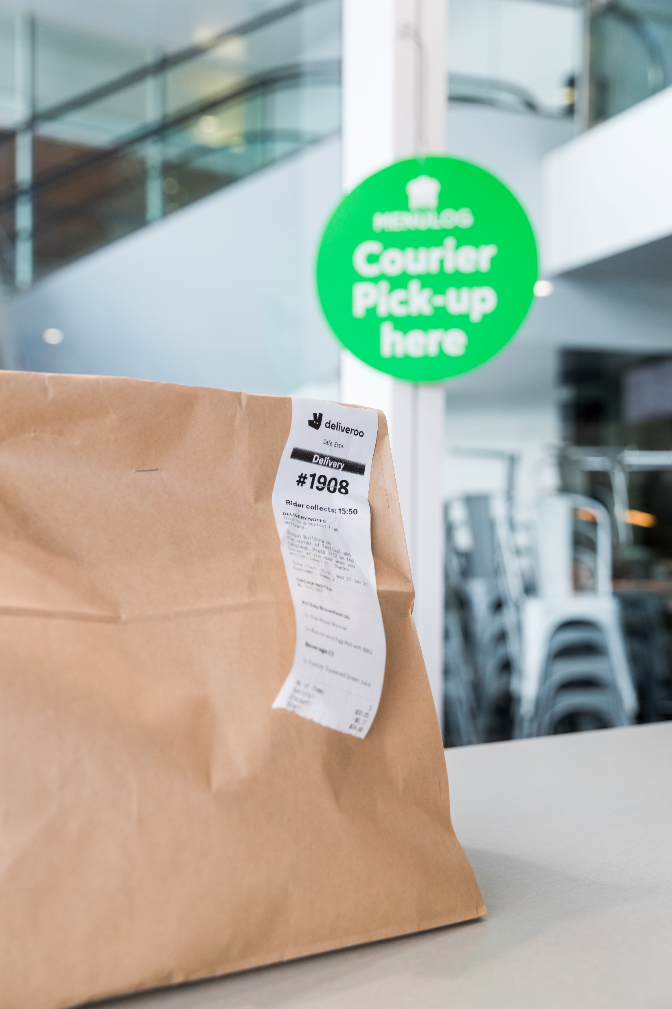
*
Food Deal-ivery
Tejal Kolte
Project Output: tool (simple web app)
Enter your delivery location and desired food order from a specific restaurant
The app will compare real-time total food delivery charges across different services and provide you with the best deal!
Data
UberEats API
DoorDash API
GrubHub API

Slide 24
Title: Kaggle Genie
Project type: Tool
Pitch: Data scientists frequently load data from Kaggle for our modeling projects. This interactive tool loads several Kaggle data sources, and coaches you through data cleaning considerations you’ll need to make before training a model.
Data Sources:
https://www.kaggle.com/datasets/PromptCloudHQ/us-jobs-on-monstercom
https://www.kaggle.com/datasets/promptcloud/uk-job-listing-dataset-from-monster
Presented by: Emily Linebarger

Slide 25
Data Analysis: Rotten Tomatoes and the Oscars
Carolina Mack
Everyone loves to reference Rotten Tomatoes scores, but how accurate and impactful are they really?
Research Questions:
How reliable are Rotten Tomatoes scores as Oscar predictors?
What is a more accurate metric for predicting Oscar outcomes: critic score or audience score?
Which award type is more closely correlated with Rotten Tomatoes score: best actor/best actress, or best picture?
Does the correlation between the two variables change with movie genre?
Data sources:
Rotten Tomatoes Dataset
Oscars Dataset

Slide 26


Yash Manne: Why is Kramer the best character?
Project output: Tool (simple web app):
Chronicle appearances of each character across the series.
Identify correlations between characters and audience ratings
Search query for partially remembered dialogue snippets
Extensions with increasingly complex NLP models
Data:
Complete scripts for all 173 episodes of Seinfeld (Kaggle)
Audience ratings for each episode (IMDb)
Viewer Counts (Wikipedia)
Smoking is injurious to health.

Slide 27
Airline Delay Prediction
Project output: a tool (simple web app)
Enter airport and weather conditions (wind, ppt., hazards, etc.)
Use a regression or machine learning model to predict the departure delay
Data
Kaggle 2019 airlines delay data
NOAA weather data
Historical weather data by location
NCEI natural disasters data
Earthquakes, storms, volcanoes, etc.
John Michael

Slide 28
Car Decision Making Interactive Helper
Project Type: Web deployed Tool
Aim: The aim of this project is help anyone interested in buying a car, displaying interactive features/segmentation on a web deployed tool
Data Sources:
https://www.kaggle.com/datasets/tymekurban/new-cars-usa-202223-dataset
https://github.com/abhionlyone/us-car-models-data
Akshit Miglani

Slide 29
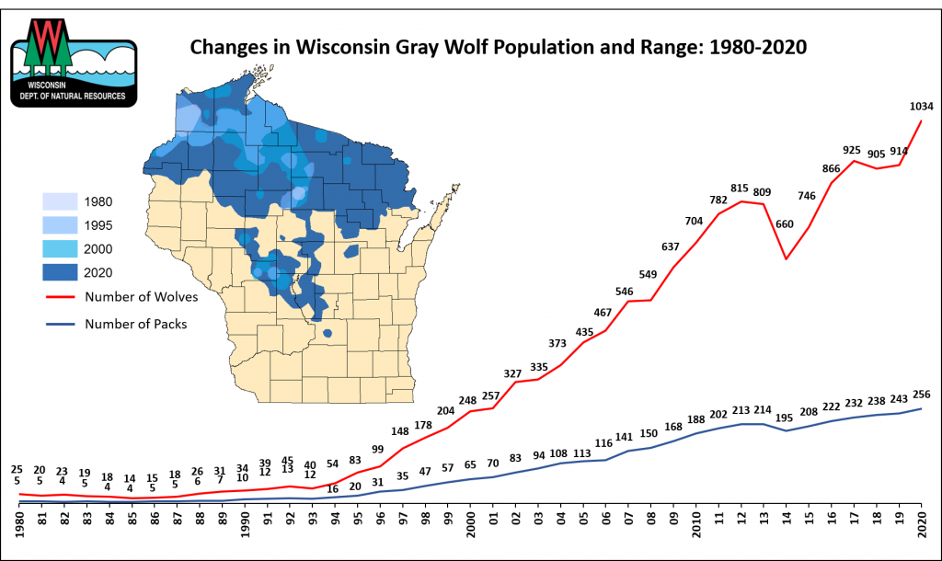
Analyzing the Wisconsin Wolf Population (Research)
By: Peter Mohammadi
Over the past 30 years the Wisconsin Wolf population has been rising
Wisconsin natives say they are dangerous and are causing the deer population to plummet, they want to kill them off
I want to explore these claims
Data Sources:
https://dnr.wisconsin.gov/
https://widnr.widen.net/s/nlrl7tzdw5/wisconsin_gray_wolf_report_2022

Slide 30
Analyzing Academic Sexual Misconduct
Research Project
The ASMD provides a comprehensive dataset of cases of academic sexual misconduct from universities and colleges across the US. This data includes information about the individuals involved, the circumstances of the misconduct, and the outcome of any investigations or proceedings. By leveraging this rich dataset, I want to gain new insights into the possible factors that contribute to academic sexual misconduct, including demographic factors such as age, gender, and ethnicity, as well as institutional factors such as university size, geographic location (extended to political affiliation, education levels of state), and type of institution.
https://academic-sexual-misconduct-database.org/download-data
https://public.opendatasoft.com/explore/dataset/us-colleges-and-universities/table/
https://www.pewresearch.org/religion/religious-landscape-study/compare/party-affiliation/by/state/
Aviva Munshi, Data 515 A Project Proposal

Slide 31
Speech To Text Engine
By: Ananya Nair
Project Type: Tool
Description: A speech to text engine is a tool that will allow the user to process human speech into a written format. The objective is to use machine learning in order to integrate grammar, syntax, structure, and composition of audio and voice signals to understand and process human speech.
Datasets: 1. https://research.google.com/audioset/
2. https://www.robots.ox.ac.uk/~vgg/data/voxceleb/

Slide 32
Recipe Generator
TOOL
A Web App
Data Sources
Build a Streamlit WebApp that generates a recipe
Input: List of ingredients you have at home.
Output: A random recipe that uses only the ingredients listed.
Recipe Box
Kaggle
Saumya Nauni

Slide 33

Exploring Weather Trends Logan O’Brien
Project Output: Reusable Data (Interactive Dashboard)
Provide a tool that allows exploration
E.g. is unusually light rainfall in January an outlier or a trend?
Data Sources:
NOAA Data
Local Climatological Data
Date range up to 1948 – Present
Monthly Summary (temperature, precipitation, wind speed, etc.)
Washington Department of Ecology
Air Quality data for many sites throughout WA
Ranging from 2010 - Present

Slide 34
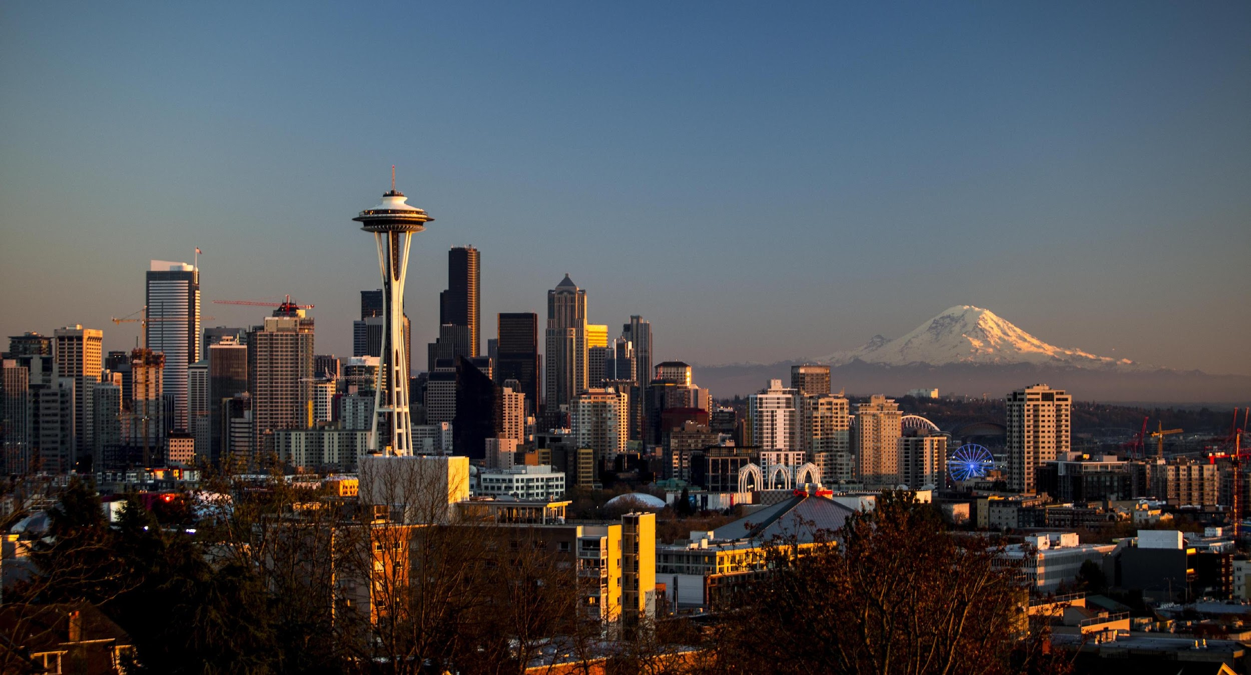
Relation between crime rates and housing prices in Seattle Aaditya Parthasarathy
Project Output: Research and reusable data (maps and web app)
The goal of this project is to analyze the data of crime statistics and housing prices in Seattle and identify any relationships between the two factors. The project will involve cleaning and preprocessing the data and creating meaningful visualizations to help illustrate the findings.
Data Sources:
Housing datasets
Kaggle houses sales data
Crime datasets
Opendata API
Crime Stats from 2008 to present

Slide 35
Project Proposal: Create an API Overlay for Smogon.com
Project Type 2: Create a Tool
https://smogon.com is a website that offers data related to the competitive viability of each Pokemon in the namesake video game series
It offers information on the stats of each pokemon, what “tier” of competition each Pokemon appears in and is legal for, as well as other information like the list of moves the Pokemon has access to
The data is publicly available through Smogon’s website but changes quickly as new trends emerge, and is not available in a form that is easy to process in an application
The plan for this project is to create an API in FastAPI that access a static dataset containing the constant information on each Pokemon and then scrapes the competitive data from Smogon on the fly when it is called for (using BeatifulSoup)
Datasets:
https://smogon.com
https://www.kaggle.com/datasets/rounakbanik/pokemon

Slide 36

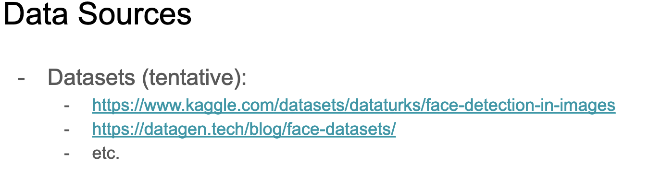
Description
Tool to extract faces from images using machine learning techniques
Implementation for training and testing
Potentially publish as a Python package to pip
Python packages for:
Training utilities given a dataset
Testing utilities given a dataset
Running utility to extract faces in separate image files given an image
Unit testing
Example commands:
python face_extract.py train <dataset directory> # trains the model
python face_extract.py test <dataset directory> # tests the model
python face_extract.py run <image path> <faces dir> # extract all faces from <image path> into <face dir>
python face_extract.py unit_tests # run unit tests

Slide 37


Crime under the Weather
Project Type: Research and Reusable Data
Analyze whether certain weather conditions have an impact on whether more or less crime is committed
Have a map to visualize certain streets or areas that could have more/less crime occurring dependent on weather conditions
Data
Seattle gov SPD Crime Data
Location of incident
Type of incident
Weather Data from NOAA
Temperature/Precipitation
Seattle Specific
Mark Qiao

Slide 38
Term Rate Conversion for Banks
Project Type: Research
Short Pitch:
The bank has various outreach plans to sell term deposits to their customers such as email marketing, advertisements, telephonic marketing, and digital marketing. Telephonic marketing campaigns still remain one of the most effective way to reach out to people. However, they require huge investment as large call centers are hired to actually execute these campaigns. Hence, it is crucial to identify the customers most likely to convert beforehand so that they can be specifically targeted via call.
Data Sources:
https://www.kaggle.com/datasets/prakharrathi25/banking-dataset-marketing-targets
https://archive.ics.uci.edu/ml/datasets/bank+marketing
- Harshit Rai

Slide 39
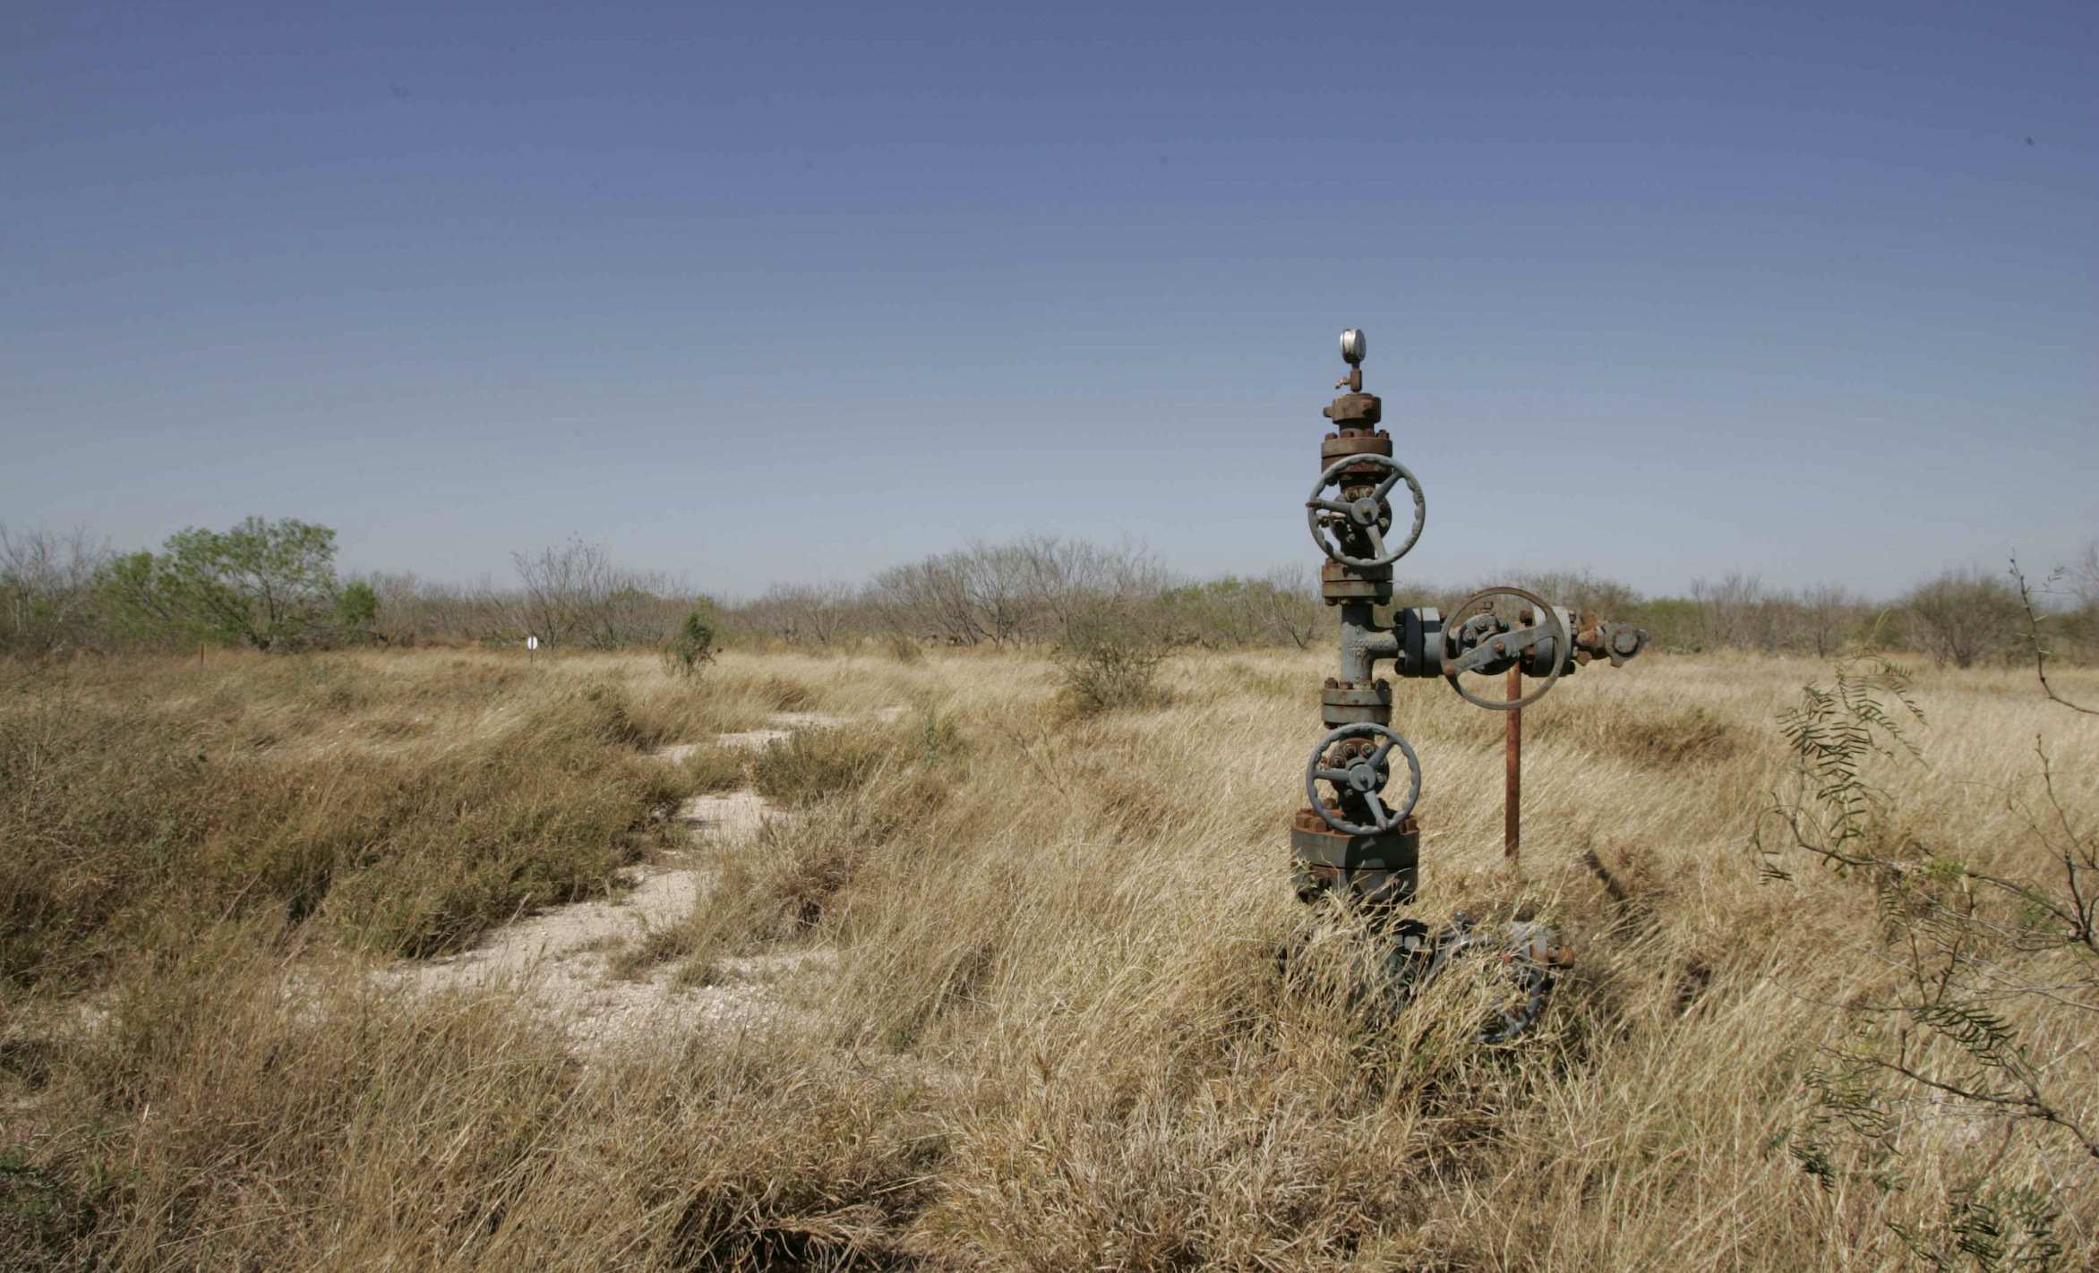
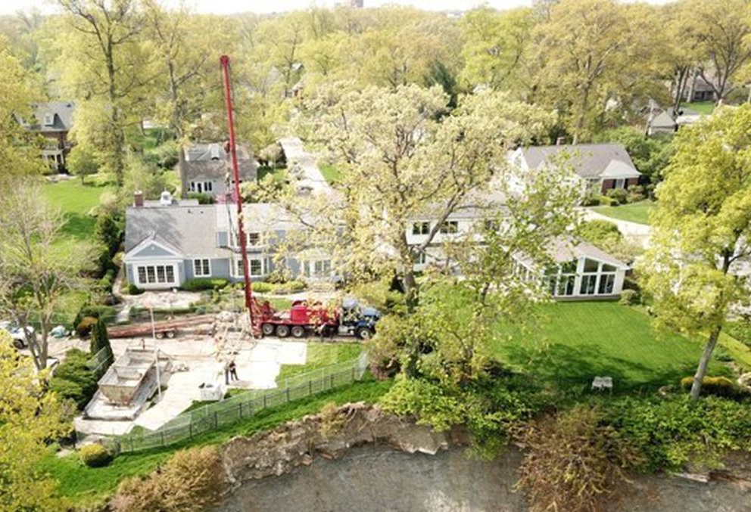
Orphaned Well Mapping Tool By Emily Rolen
Proposal:
Orphan gas/oil wells present significant health and environmental risks to those that live and work nearby
Recently approved federal funding to cap orphan wells has lead to significant data collection efforts
No tool currently exists to search orphan well locations
Create a searchable map of orphaned gas wells to identify sites near population centers and points of personal interest
Data sources:
Documented Orphaned Oil and Gas Wells Across the United States (2021 & 2022)
Population Density Information (2010 US Census)

Slide 40
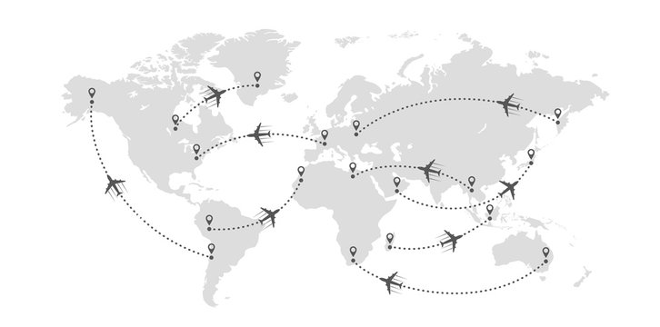
BEAT THE CROWD! FRANCES SCOTT-WEIS
*
Project Output: Web App (Tool)
User input: desired destination and/or dates of travel
Use a ML model to predict how busy a travel destination will be at some point in the future
Output:
Time series visualization of predicted busyness over time for a specific destination
Heatmap visualization of predicted busyness in different locations for a specific time frame
Data
World Bank International Tourism Demographics
United Airlines Traffic and Capacity
Notes:
https://www.kaggle.com/datasets/ayushnitb/tourist-numbers-univariate-forecasting-dataset
https://data.world/adamhelsinger/united-airlines-data/workspace/file?filename=Traffic%26Capacity+United+Airlines.xls

Slide 41

Airbnb Recommender – Top 5 Airbnbs in your Desired City in the US
Project output: A Visualization tool or Web App
Recommend Top 5 Airbnb Hosts for a specific US City based on Popularity, Budget, Reviews, Type of Rooms and Neighborhood of your choice
Use a machine learning model to classify Airbnbs as High, Medium, Low
Create Visualization with filters and recommendations with all listings on the Map
Perform overall city and state level # of Airbnbs analysis
Data
Airbnb USA Listings – link
Airbnb US listings for 15 states and 30 unique cities
Airbnb Name, Demographics, Review, Price, Room Type
US Airbnb Open Data – link
Airbnb Name, Demographics, Review, Price, Room Type
Neel Shah

Slide 42

FRAME - Food Recommendations For All Methodical Eaters
Arjun Sharma
Zip-Code: 91101
Latitude and Longitude:
Cuisine: American
Food Type: Salad
Calories Per Serving: 400 - 600
Max Distance: 5 mi
Allergies: None
Price Range: $10 - $25
Misc. Preferences: High Protein, Low Sodium, Low Fat, Vegan
Restaurant Rating: 3+
Project Type: Tool
Data Sources:
Uber Eats Restaurants and Menus
New York Public Library (What’s on the menu?)
Data.gov
Yelp Reviews
Brussels Sprouts
Magnolia House - ☆☆☆☆,
336 S Lake Ave Pasadena, CA 91101,
2.4 mi away,
$14.99,
450 Calories
Caesar Salad
GRANVILLE - ☆☆☆,
270 S Lake Ave Pasadena, CA 91101,
3.4 mi away,
$17.99,
550 Calories
Buddha Bowl
Urban Plates - ☆☆☆☆☆,
269 S Lake Ave Pasadena, CA 91101,
1.8 mi away,
$21.99,
570 Calories
Procedure:
User preferences taken as input.
Based on Content-Based Filtering and Collaborative Filtering, suggest the top 10 dishes and the restaurants that offer them.
Show relevant details on clicking on a suggested dish (Restaurant address, Distance from location, Nutritional Information, Price).
Show the 5 most recent reviews of the restaurant.

Slide 43
Global Power Plants and Energy Consumption Analysis
Mithali Shashidhar
Project Output: research and reusable data (data visualization and analysis)
Research how economic indicators affects a country’s energy choices.
Do countries that have a higher GDP invest in clean energy more than others?
Are countries with a higher proportion of educated youth per capita more inclined towards using renewable sources of energy?
Build map visualizations that answer these questions.
Include search bars and filters to drill down on countries.
Data:
https://www.kaggle.com/datasets/ramjasmaurya/global-powerplants
https://databank.worldbank.org/source/world-development-indicators

Slide 44
Airline Crew Pairing/Scheduling (Research)
Problem
Update now-antiquated current industry solutions for optimizing scheduling flights for commercial airlines.
Objective: Minimize costs (airplane expenses, fuel, crew, and equipment) while ensuring all flights and crew members are covered exactly once.
Crew Pairing → Assign airline crew members to a crew such that all crew members’ constraints are satisfied
Max. hrs/week
Requested vacation time
Domestic/International rules
Crew Scheduling → Assign crews to a series of flight such that all FDA/safety constraints are satisfied
Flight connectivity
Efficient route
Datasets
https://www.sciencedirect.com/science/article/pii/S2192437620300820
https://github.com/crewml/crewml
https://github.com/SreekarJammula/Flight-Data-Analytics-

Slide 45
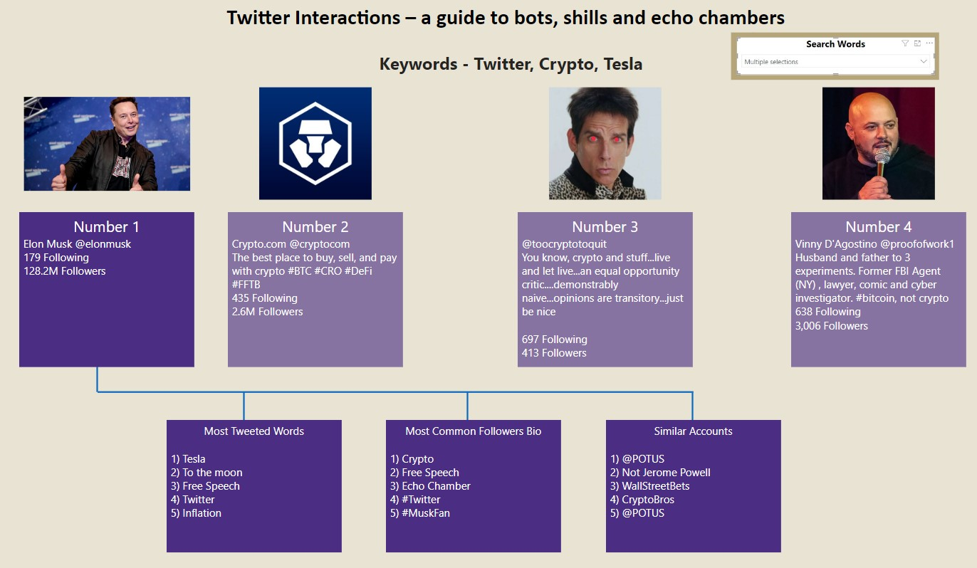
Twitter Interactions – a guide to bots, shills and echo chambers
Raman SV
Project type: Create a Tool
Data sources :
1) Twitter API via their developer platform
2) Google News API for trending topics
Pitch
1) Search by key terms and get results of top Twitter users for these terms (KNN Algorithm?)
2) Click on the results and get a deep dive on bot presence and retweets for this profile
3) View similar profiles and their bios, which resets the list to show their top followers and catch words
4) Integrate trending news and hotlist of words to search for users who populate these echo chambers

Slide 46
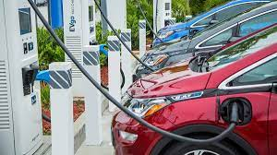

Charge Me Up!
Project output: research & map visualizations
Research electric vehicle charges to check correlation between charging stations and vehicle registration
Build map visualizations to show electric vehicle and charger density for various types of vehicles, electric vehicle range, and chargers
Data
Electric vehicle (battery and plug-in hybrid) vehicle registry in Washington State [data.wa.gov]
Elective vehicle charging station locations [afdc.energy.gov]
Kevin Torrico

Slide 47
VACATION FINDER
A TOOL FOR PREDICTING POPULAR TRAVEL DESTINATIONS
ADITHYAA V
PROVIDE INSIGHTS INTO THE DESTINATIONS THAT ARE LIKELY TO BE THE MOST POPULAR IN THE FUTURE, HELPING TRAVELERS PLAN THEIR TRIPS.
PROVIDE VALUABLE INFORMATION FOR GOVERNMENTS AND TOURISM ORGANIZATIONS TO HELP THEM PLAN FOR THE FUTURE AND MAKE DECISIONS ABOUT HOW TO ATTRACT MORE TRAVELERS.
TRAVELERS WILL BE ABLE TO PLAN THEIR TRIPS WITH CONFIDENCE, KNOWING THAT THEY WILL BE VISITING THE DESTINATIONS THAT ARE LIKELY TO BE THE MOST POPULAR IN THE FUTURE.
PREDICT THE MOST POPULAR TRAVEL DESTINATIONS BASED ON THE HAPPINESS INDEX, THE NUMBER OF INTERNATIONAL TRAVELERS, ETC.
UTILIZE MACHINE LEARNING ALGORITHMS, SUCH AS LINEAR REGRESSION, DECISION TREES, AND RANDOM FOREST, TO GENERATE PREDICTIONS.
DATA SOURCES:
WORLD BANK DATA (HTTPS://DATA.WORLDBANK.ORG/INDICATOR/ST.INT.ARVL)
WORLD HAPPINESS REPORT (HTTPS://WORLDHAPPINESS.REPORT/ED/2020/)

Slide 48
Climate Change and Wildfire in the US: An Analysis
Project Type: Research Project
Aim: The aim of this project is to investigate the effect of climate change on the likelihood and severity of wildfires in the United States. The goal is to understand the relationship between wildfires and climate factors by combining data on wildfires and climate factors with information on land cover and vegetation type. My goal is to provide insights and recommendations for fire prevention and management strategies in a changing climate.
Data Sources:
National Interagency Fire Center (NIFC) – Science Base
United States Geological Survey (USGS) – Science Base
National Centers for Environmental Information (NCEI)
Ishank Vasania

Slide 49
Electric Vehicle Charging Heat Map
Project Output: a tool that helps visualize the popularity of a charging station for electric vehicle (EV) charging
Calculate a popularity score for EV charging stations based on zip code, capacity, number of nearby charging stations and number of EVs registered in the area
Create heat map based on charging station locations
The purpose of the tool is to indicate if a certain area is lacking charging stations or if any existing charging stations will likely to be full
Data
Washington state EV population data (Link)
Washington state EV charging stations data (Link)
Contact: Jason Wang

Slide 50
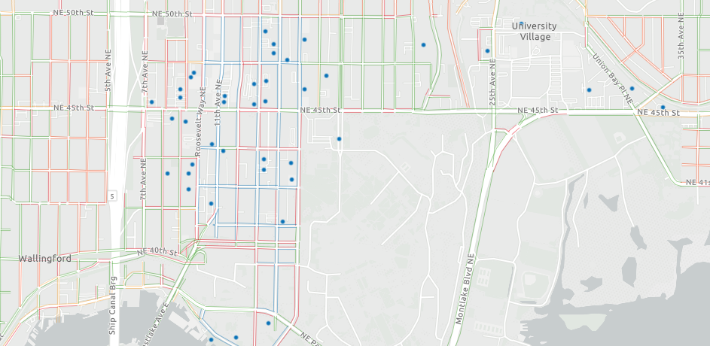
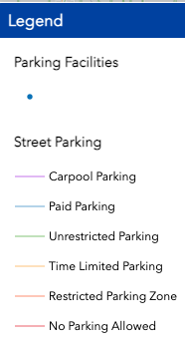
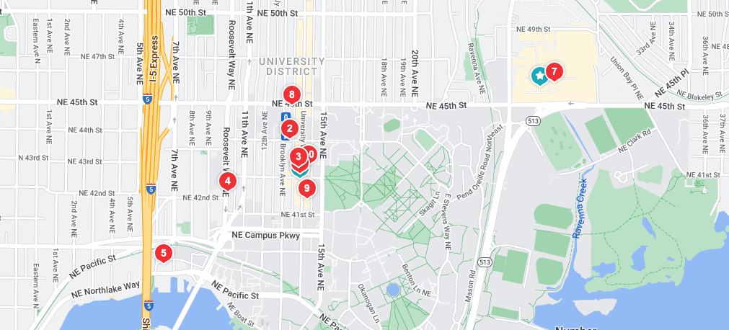
Where to Park?
A tool to help people find the best place to park their car around destination.
Jenny Wong
Data Sources:
Seattle GeoData Blockface API
https://data-seattlecitygis.opendata.arcgis.com/datasets/SeattleCityGIS::blockface/about
Yelp Fusion API
https://docs.developer.yelp.com/docs/fusion-intro
Main Idea:
Seattle GeoData developed a map labeling every street for whether it is able to street parking or not. However, it is not searchable by names of the places.
I would like to combine the location of stores in Yelp with the parking map, to give users a list of possible street parking location or garage, and rank and recommend the best location.

Slide 51
Tourist Places Recommendation System
Name: Tanushree Yandra
Project Type: Tool
About:
The aim of this tool is to recommend popular places in and around Seattle visited by tourists based on factors like the type of place the user wants to visit (museums, cafes, trails, beaches, etc.), proximity, budget, day, time, weather, and so on. I have always found recommendation systems interesting and thought it would be really cool to build one platform that suggests places on such a large number of factors.
Datasets:
https://mygeodata.cloud/data/download/osm/tourist-attractions/united-states-of-america--washington/king-county/seattle
https://www.kaggle.com/datasets/oklena/seattle-area-restaurants
https://data.seattle.gov/Parks-and-Recreation/Seattle-Parks-and-Recreation-GIS-Map-Layer-Web-Ser/f5g8-sb93

Slide 52
Seattle Weather Prediction
Project output: research & reusable data (map visualizations)
Build a map visualization to show how temperature and precipitation change in Seattle
Research how season, temperature and precipitation are related
Predict whether it will rain on a certain day based on temperature and precipitation on previous days
Data:
NOAA data of weather
Temperature and precipitation dataset from Kaggle

Slide 53


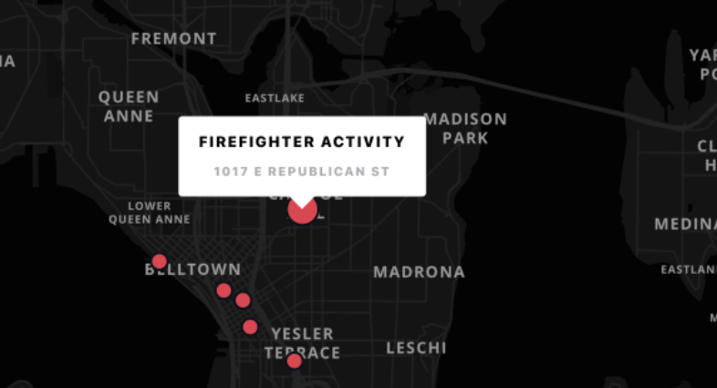
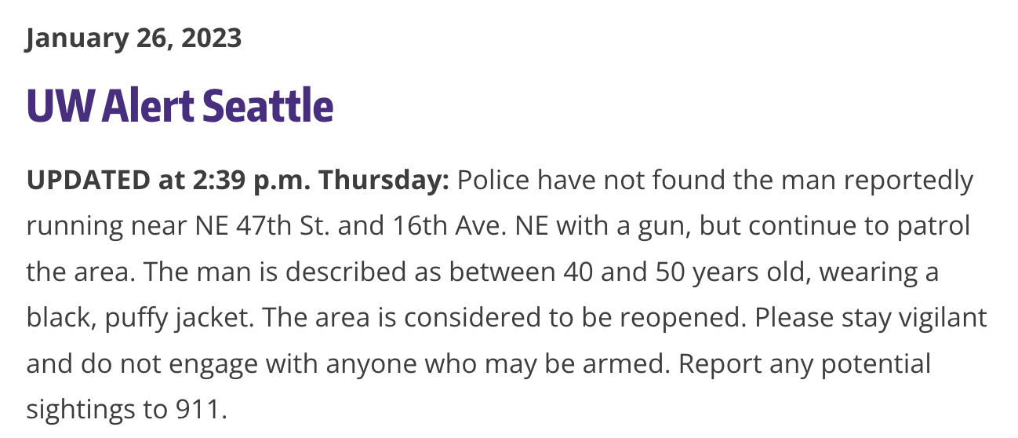
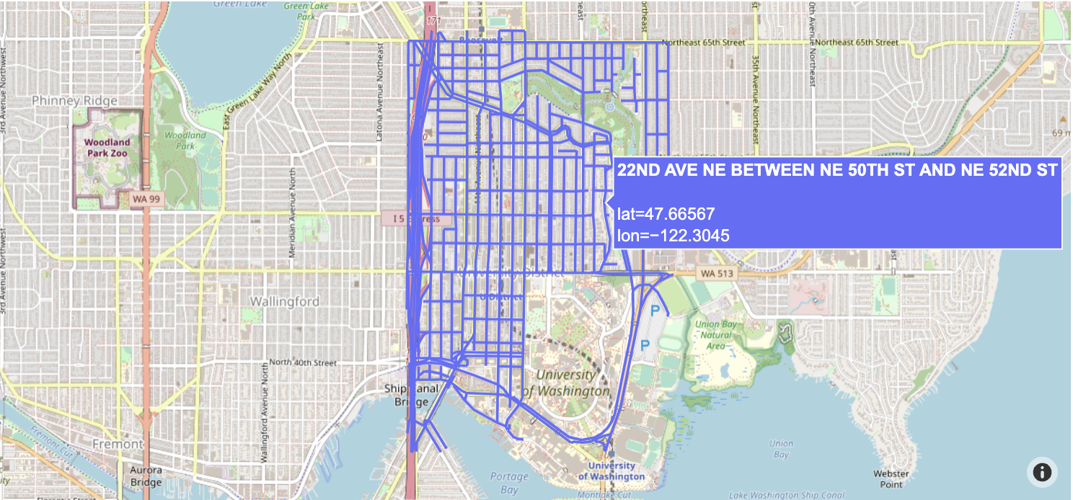
UW Alerts Application
Evan Yip
Project type: Tool Project
Project Pitch: The goal of this project is to build a interactive web application and visualization that displays the trends and updates from the UW alert notification system. The goal is to be able to create a proof of concept visualization that parses through real-time UW alerts onto a map. This is a similar application to the citizen app.
Tools: Plotly, Mapbox, Flask
Data Sources:
UW Alerts Blog
Seattle GeoData Streets

